Slide 1
DYNAMIS-POP http://ihsn.org/projects/dynamis-pop
Dynamic Microsimulation Population Projection in Developing Countries
Martin Spielauer, Olivier Dupriez
IMA June 2017

Slide 2
DYNAMIS – Project Background
Funding
  World Bank Knowledge for Change Program
  International Household Survey Network Trust Fund from the UK Dep. for International Development executed by the World Bank Development Data Group
Team
  Olivier Dupriez – The World Bank - Lead
  Martin Spielauer – Consultant – Implementation
  CMAP Centre Mauritanien d’Analyse de Politiques,
  ONS National Statistical Office : Local Experts

Slide 3
DYNAMIS – Purpose and Objectives
Purpose: Demonstrate feasibility and relevance of dynamic micro-simulation for population projections in developing countries
Objectives
  Highly disaggregated population projections
  Core component for a more comprehensive modular model for simulating the impact of social development policies and programs
Status
  Modular model; replicable, openly accessible
  Pilot application for Mauritania

Slide 4
DYNAMIS – Characteristics & Philosophy
Portable platform
  Based on data available for most countries
  Refinable, extendable & adaptable to specific contexts
Start from the ‚known‘ (available macro projections)
  Model can reproduce macro models: same assumptions, parameter tables -> same outputs
  More refined models can be added and selected with and without alignment to macro projections
Reproducible
  Step-by-step documentation (stats & programming)
  Freely available software (language & app)

Slide 5
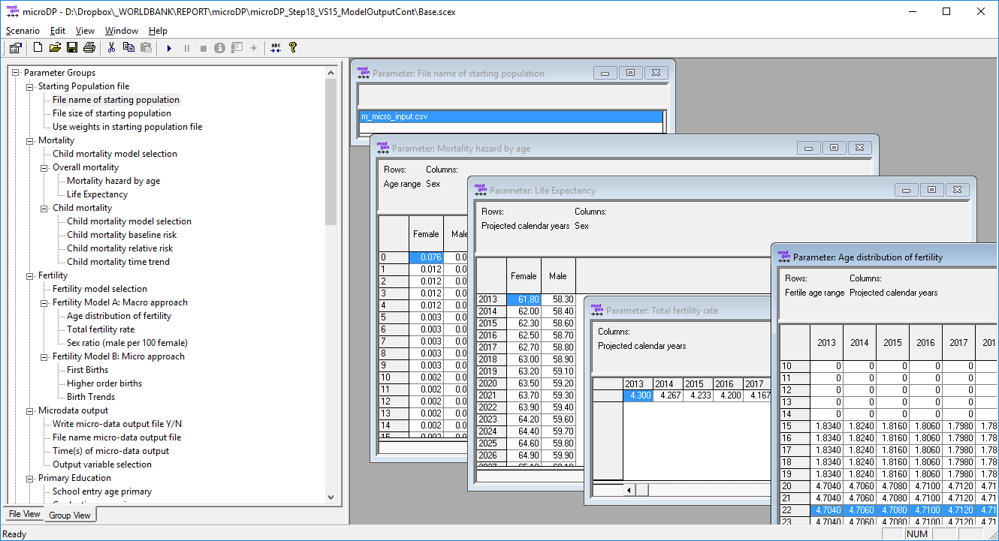
DYNAMIS – Modgen / GUI

Slide 6
DYNAMIS – Fertility
Base Version
  Age-specific fertility distribution by year
  Total Fertility Rate (TFR) by year
Extended Version
  First births by age, union status, education, province
  Higher order births by education, time since last birth
  Separate trends by birth order
Alignment Choices (extended version)
  Not aligned
  Aligned to total births of base version
  Aligned to total births by age of base version

Slide 7
DYNAMIS – Mortality
Base Version
  Standard life table of age-specific rates by sex
  Life expectancy by calendar year and sex
Refined child mortality model (ages 0-4)
  Age baseline
  Relative risks by mothers education and age group
  Age-specific overall trends
Alignment options (refined model)
  Without
  Initial alignment to base model – trends from base
  Initial alignment to base model – specific trends

Slide 8
DYNAMIS – Internal Migration
Base
  Probabilities to leave by province, age group and sex
  Distribution of destinations by origin, age, sex
Refined
  Education added to probability to leave

Slide 9
DYNAMIS – Immigration and Emigration
Immigration
  Immigration numbers by year and sex
  Age distribution by sex
  Destination distribution by sex and age
Emigration
  Emigration rates by province, age and sex

Slide 10
DYNAMIS – Primary Education
Base: Probabilities of school entry and graduation by year & province of birth, sex
Refined: adding mothers education

Slide 11
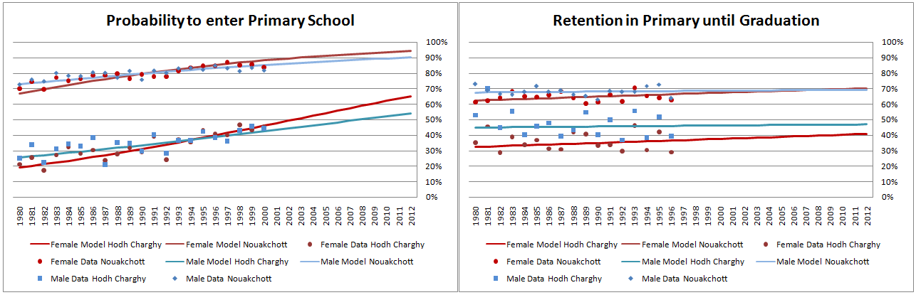
DYNAMIS – Primary Education
Based on proportional models (logistic regression)
High and persistent inter-provincial differences

Slide 12
DYNAMIS – Primary Education - Scenarios
Scenarios on overall trends by sex
Scenarios on provincial trends (convergence)
Scenarios for study of composition effects by mothers education only

Slide 13
DYNAMIS – First Union
Option A: Age-specific rates by age and cohort
Option B: Parametric model by Coale & McNeil
  Parameters: lowest and average age at first union formation and final outcome of ever entering a union
  Simulation results can be used as base for option A (which can be easily modified e.g. to a scenario banning child marriages)

Slide 14
DYNAMIS – First Union - Analysis

Slide 15
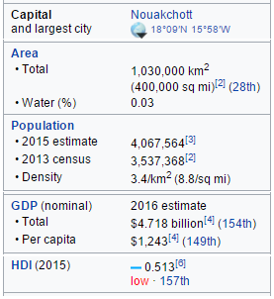
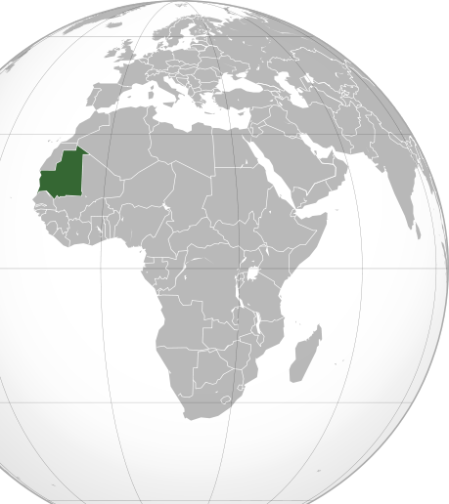
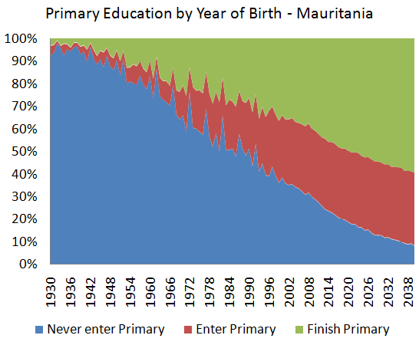
Example: Universal Primary Education in Mauritania

Slide 16
Example: Effects of Education
2 Scenarios:
  Base: Continuing observed trends
  Alternative: Phased-in universal primary reached 2030

Slide 17
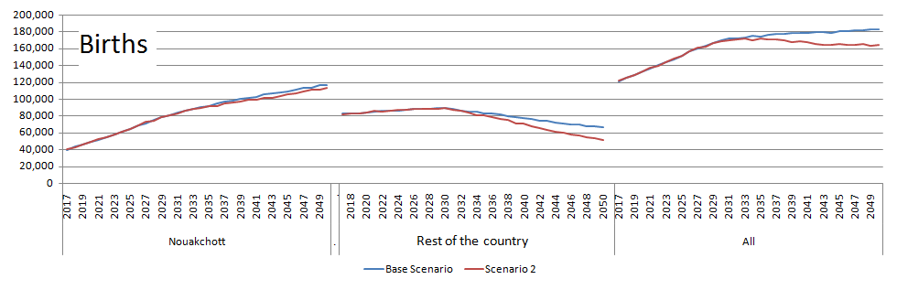
Example: Births

Slide 18
Example: Early Teenage Births

Slide 19
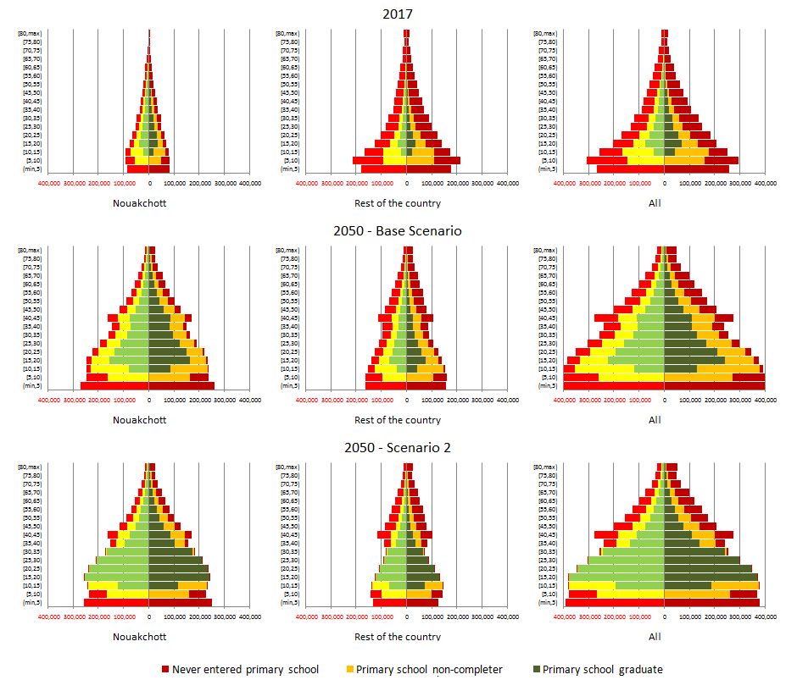
Example: Age distribution by eduaction

Slide 20
Example: Births by Mothers Education

Slide 21
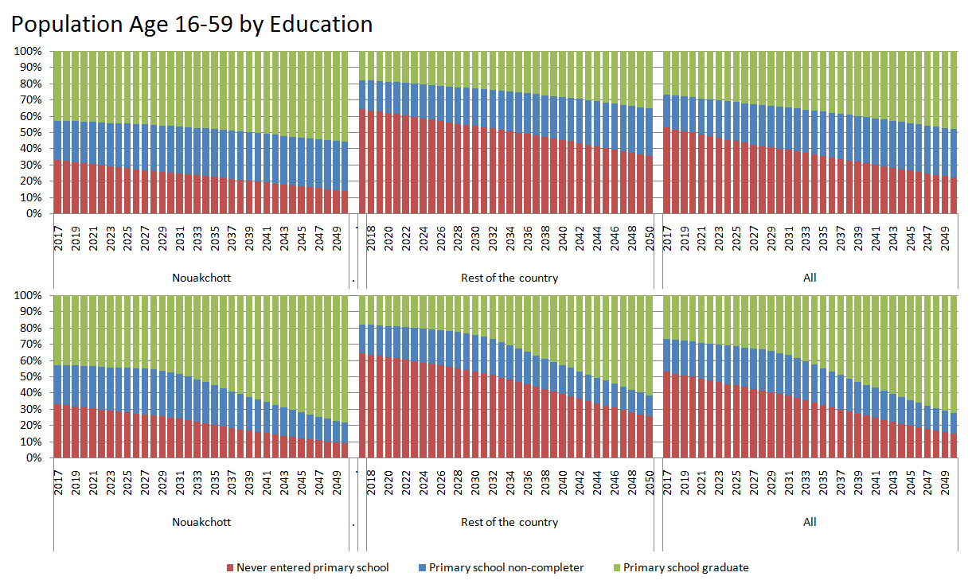
Example: Education Composition 16-59

Slide 22
Example: Deaths

Slide 23
Outlook
Model currently ported to Nepal
New modules for education
  Tracking of school attendance by grade
  Higher education
  Functionality for planning
More disaggregation: e.g. ethnicity, geography
Collaboration with WorldPop - Geo-referencing
New module for internal migration
Focus: Tool supporting analysis connected to Sustainable Development Goals (SDG) and SDG indicators

Slide 24
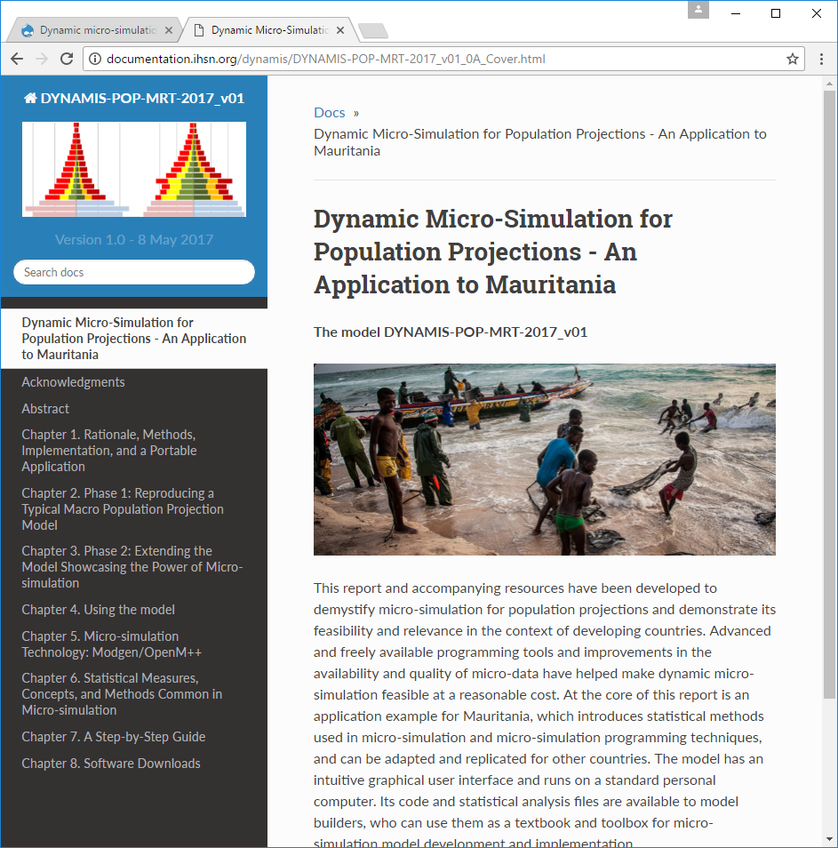
Documentation
Detailed Report
Software Downloads
Step-by-Step Model
implementation instructions
(“Modgen Textbook”)
Statistical analysis
(Stata .do) files
Anonymised Census sample
Starting Population
http://ihsn.org/projects/dynamis-pop

